Slide 1
FRB Update #24
William Huang
(12/1/2020)

Slide 2
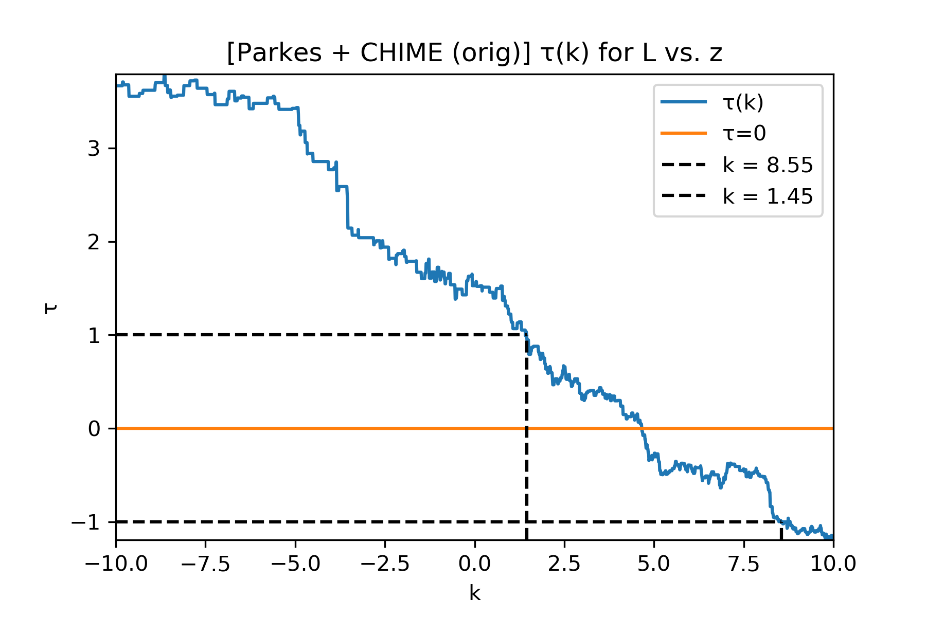
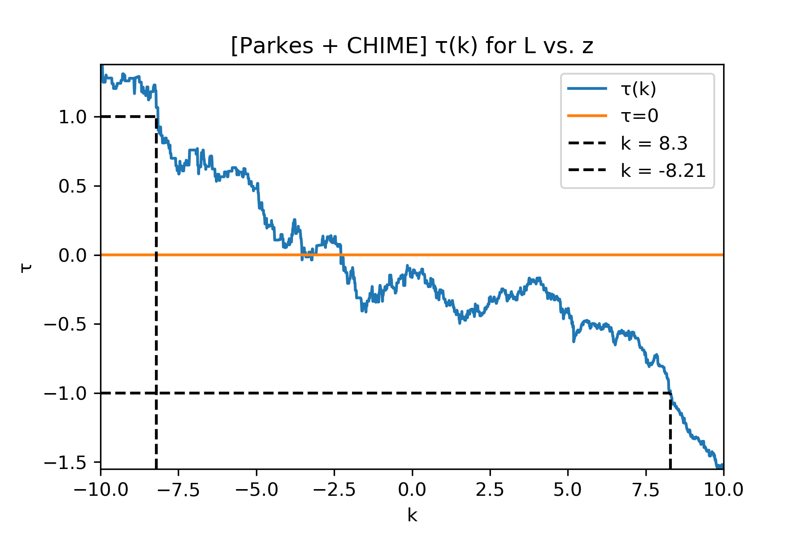
Kendall Tau (L vs. z)
For the original Parkes + CHIME dataset, the kendall tau reached 0 at around k=4. Unfortunately, the new estimated dataset reached 0 at around k=-3. On the left is the original dataset, and the right is the dataset including estimated numbers.

Slide 3
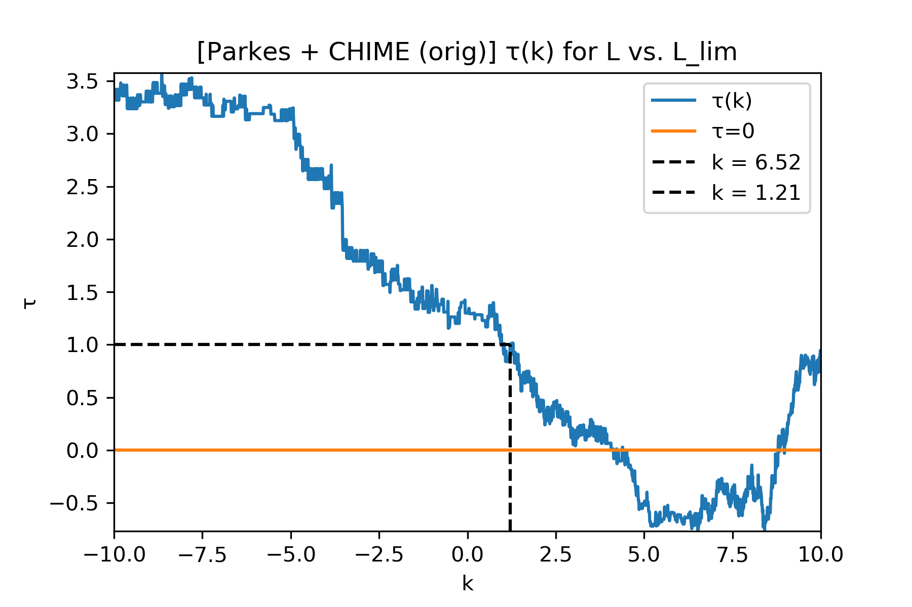
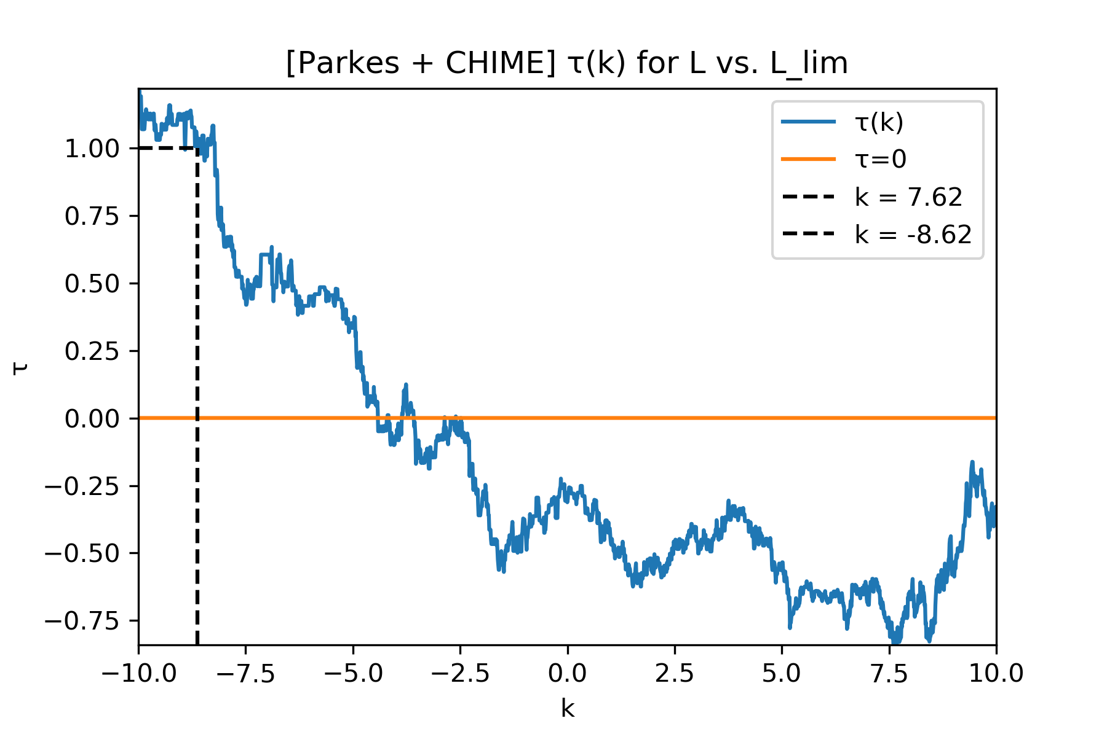
Kendall tau (L’ vs. L)
The kendall tau graphs for L’ vs. L are provided

Slide 4
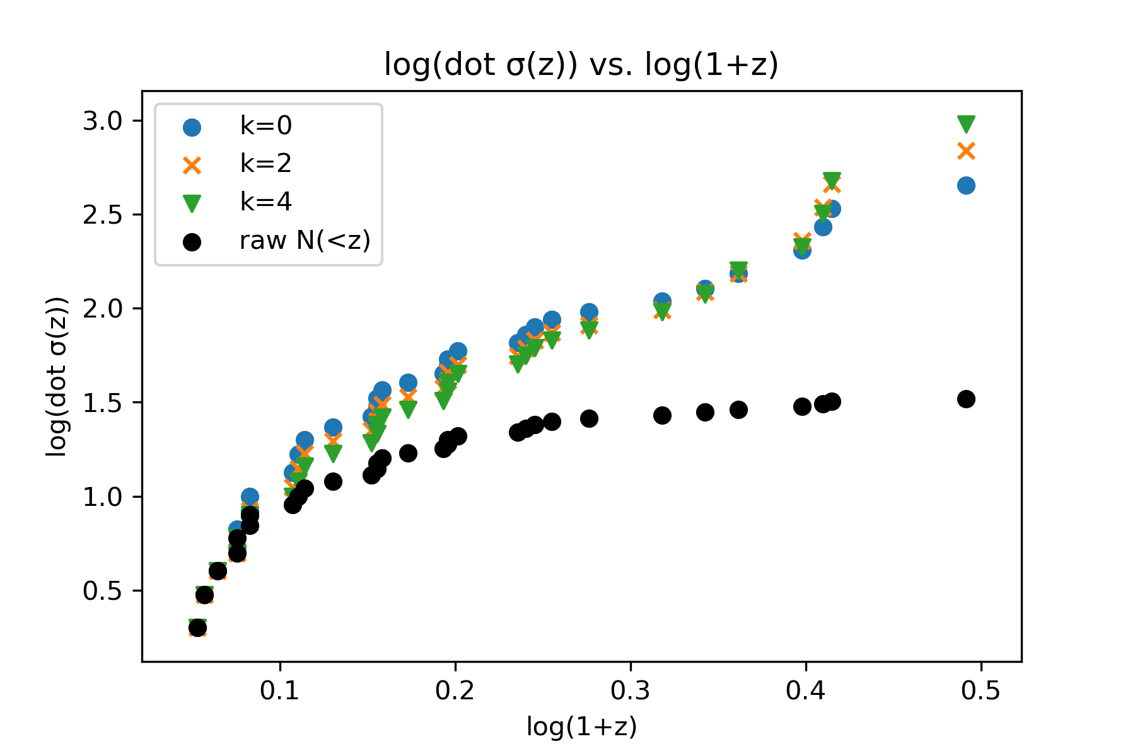
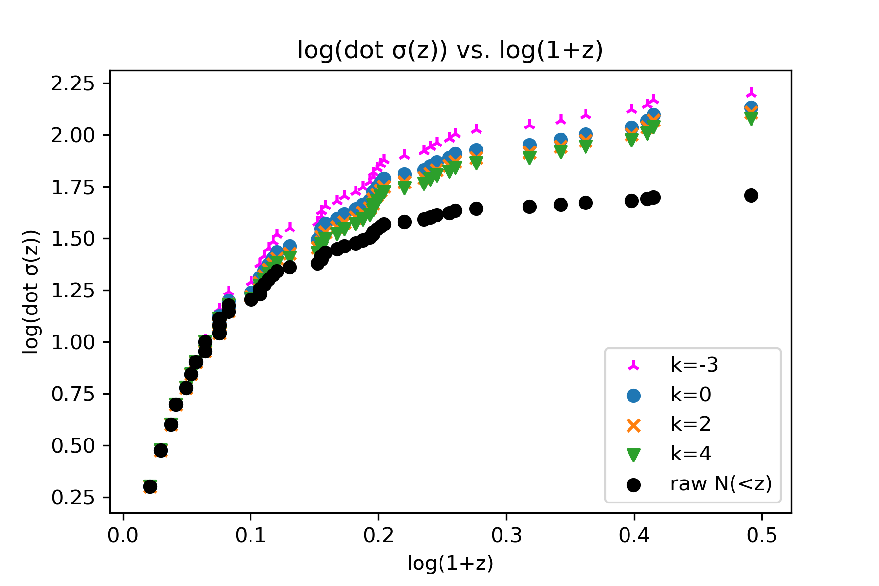
Dot sigma
The dot sigma for the original dataset (on the left) and the dataset including estimated values (on the right) are shown. k=-3 was included for the right graph.

Slide 5
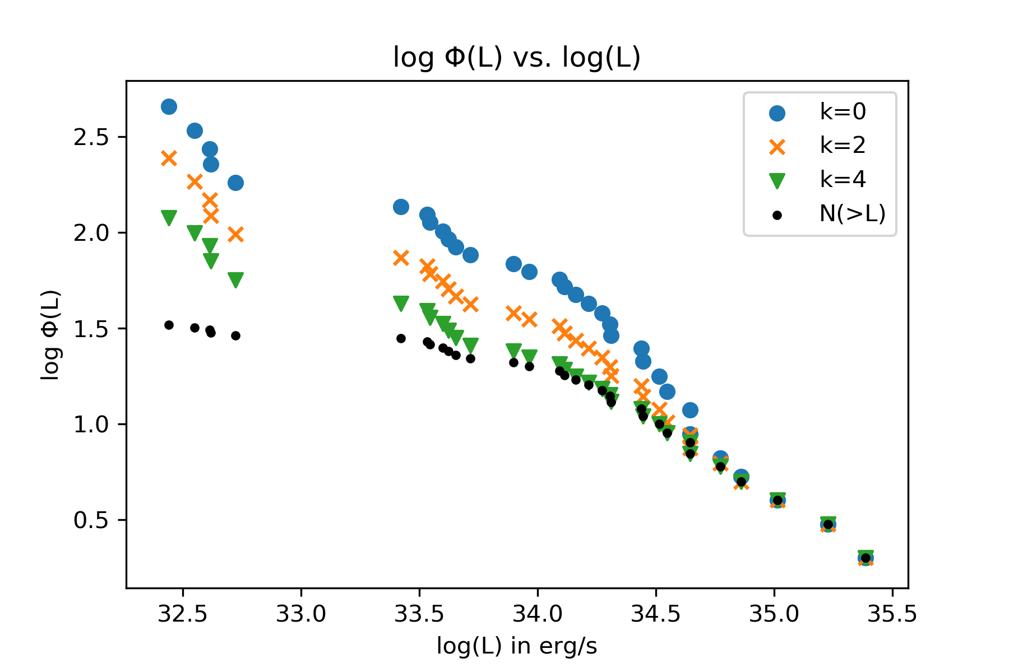
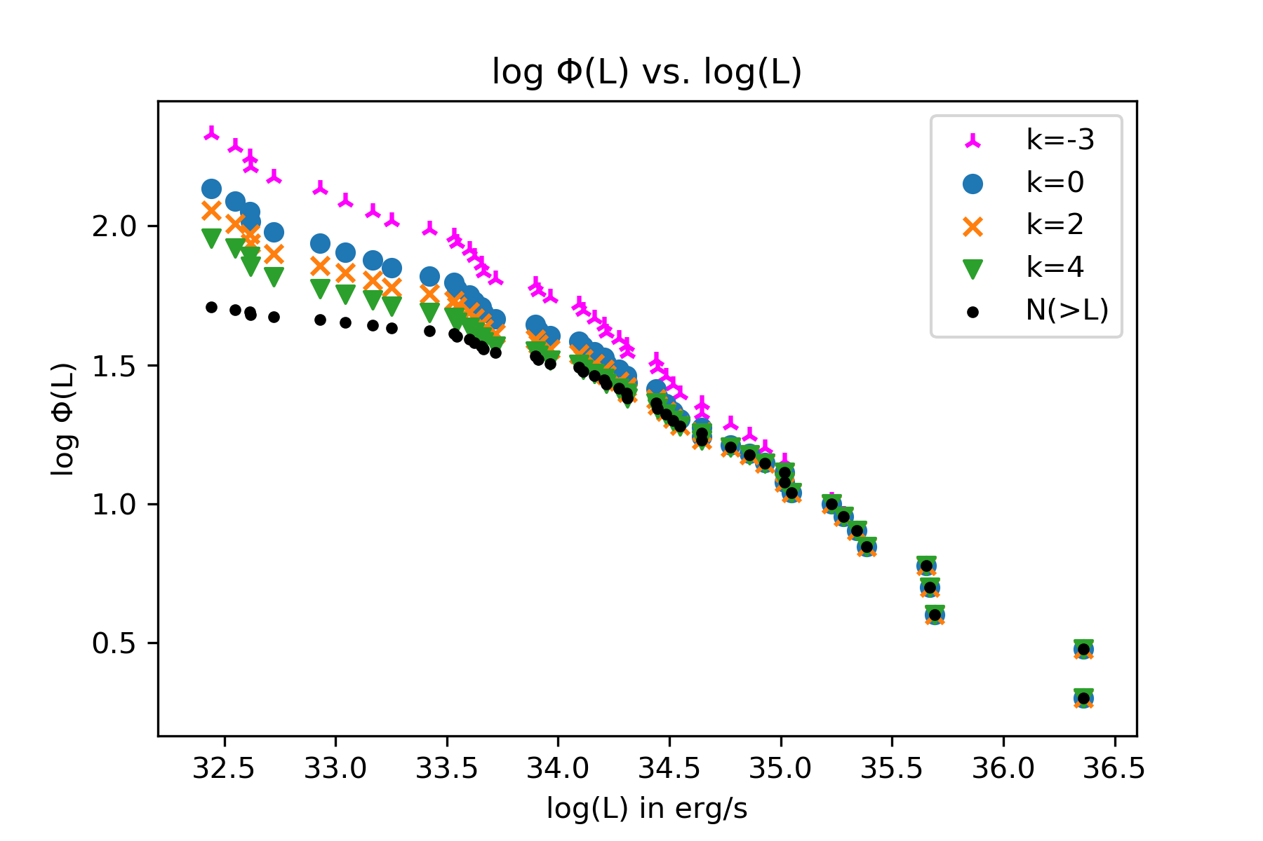
Phi(L)
Phi(L) is shown. Again k=-3 is included on the right graph.

Slide 6
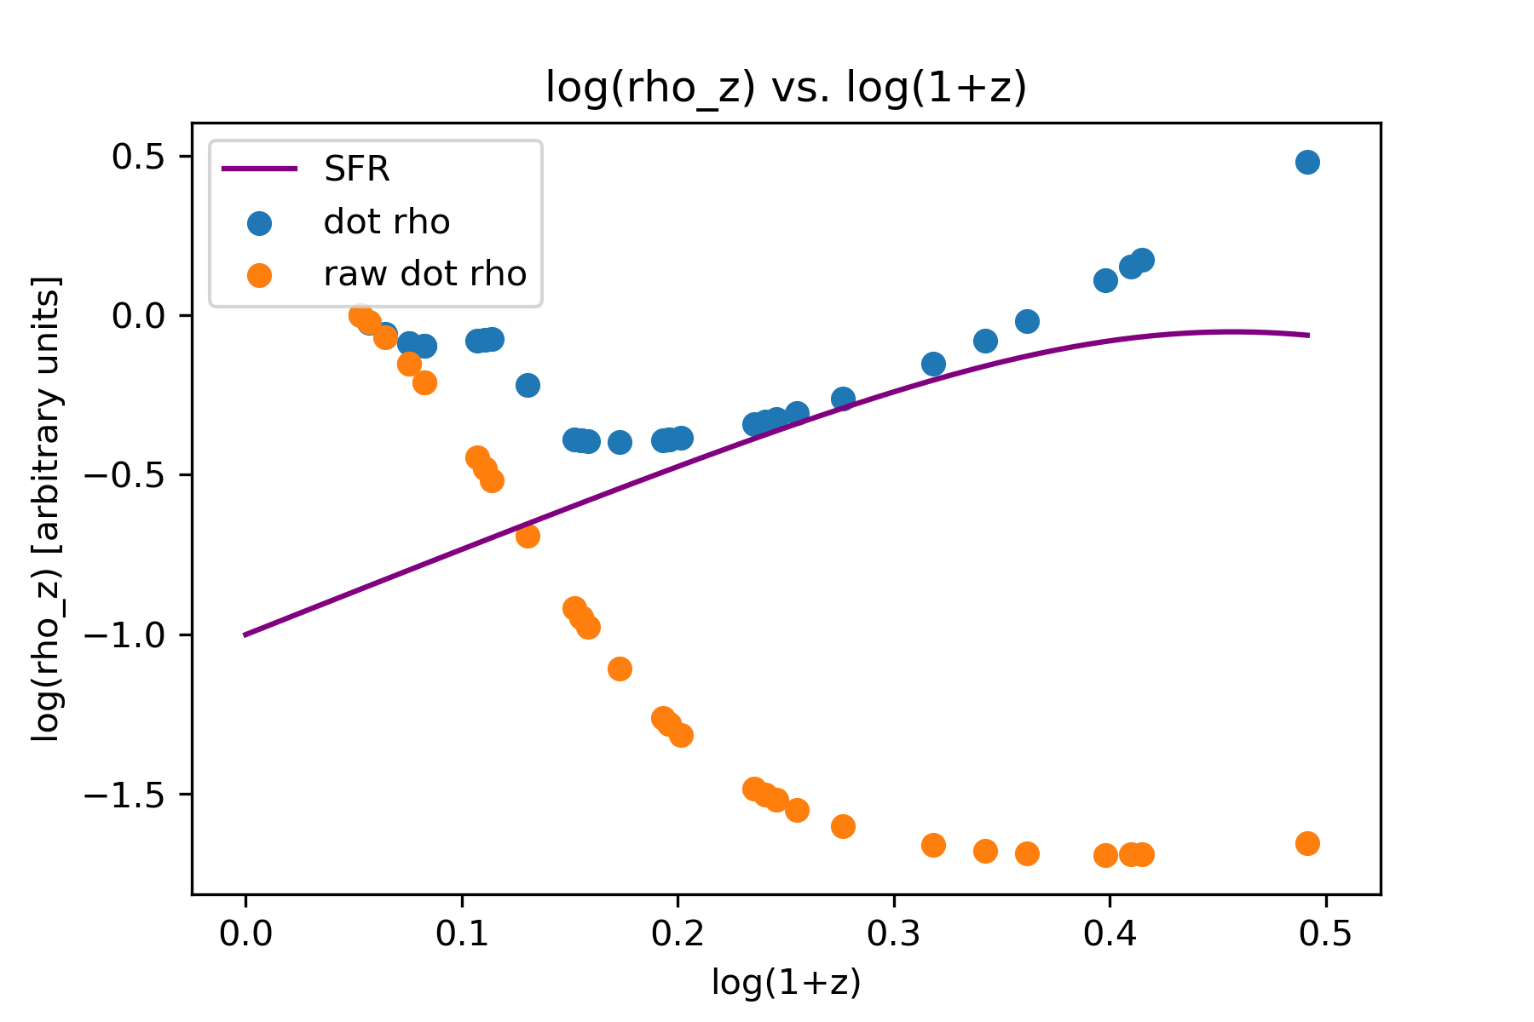
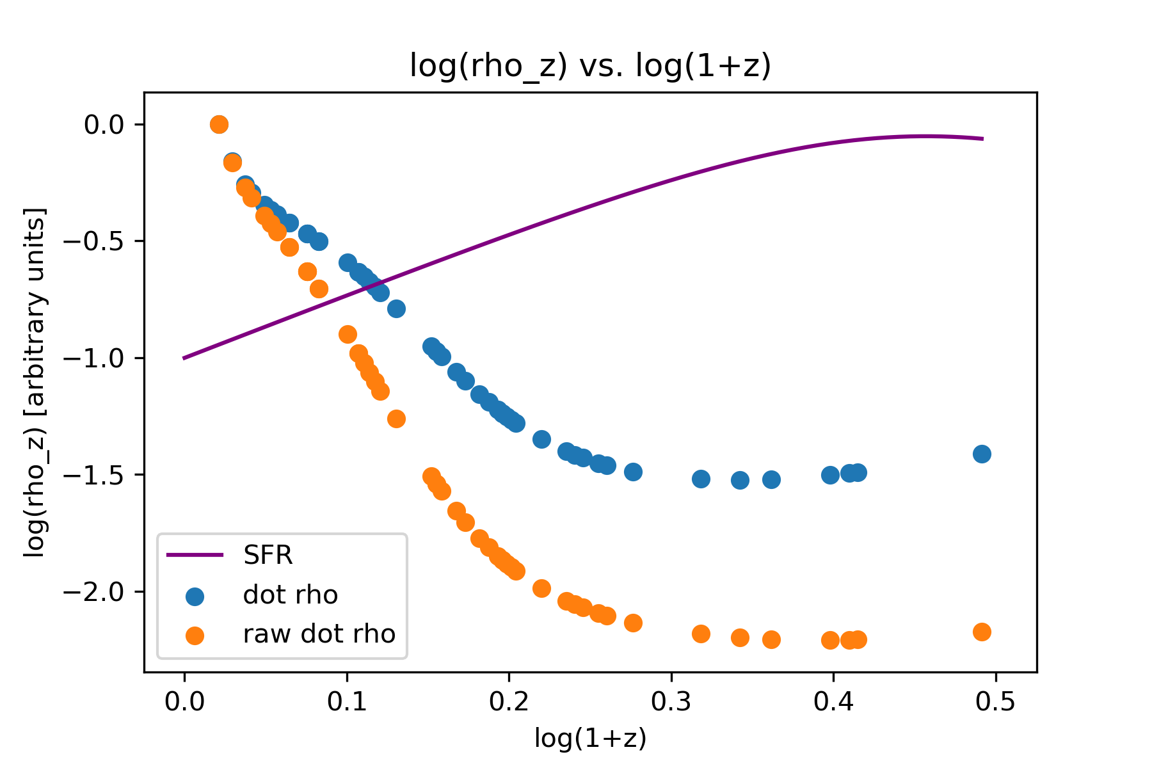
Dot rho
Graphs of dot rho are shown, including the star formation rate. The right graph includes the estimated values and is evaluated at k=-3, while the left is evaluated at k=4

